Slide 1
LEADERSHIP
( Importance, Qualities & styles )

Slide 2
LEADERSHIP
Leadership is defined as influence that is the art or process of influencing people so that they will strive willingly & enthusiastically towards the achievement of group goals.
Definitions of Leadership
Ordway Tead – The activity of influencing people to co-
operate towards same goal which they come
to find desirable.
Keith Davis –Leadership is the ability to persuade others to
seek defined Objectives enthusiastically. It is
the human factor which binds a group together
& motivates it towards it’s goals

Slide 3
IMPORTANCE OF LEADERSHIP
The behavior of the leader directly affects the motivation of
workers
The leader is a vital for enterprise.
The leader designs & modifies planning organizing & control
mechanism.
The leader is responsible for crucial decision making
The leader is the rescue boat to the survival of the work group.
Leadership transforms the potential into reality.
Leadership alone can convert cherished dreams vision & plans into
realities.
A managers contribution in utilizing employee resources is hardly
60% but when the contribution induced by leadership ability of the
manager can be about 40% to the employee resources utilization.

Slide 4
QUALITIES OF MANAGEMENT LEADER
Futuristic Vision
Inspired & spontaneous dynamism to excel & help
Respect to others
Spirit of Sacrifice
Place of work as place of worship.
The leader is sincere & honest
The leader is ready to share all the work that the worker do.
The leader is pure mind & heart.
He sets his own example before his followers

Slide 5
LEADERSHIP FUNCTIONS
Guidance & motivation
Understanding problems & feeling subordinates
Influencing & shaping the social system.
Use of persuasion
Voluntary co-operation

Slide 6
DELEGATION OF POWERS & LEADERSHIP
Louis A. Allen – It is the ability to get results through others.
Also the transfer of responsibility by the superior to his subordinate is known as delegation.
Elements of Delegation :-
* Delegator assigns duties
* Delegator grants authority
* Delegator creates obligation
* Delegator retains accountability.
The manager or leader of any business organization utilizes this delegation of authority for completion of work by his subordinate

Slide 7
STYLES OF LEADERSHIP
Autocratic Leadership :-
Managers retains as much power and decision – making authority as possible. The managers does not consult employees, nor are they allowed to give any input. Employees are expected to obey orders without receiving any explanations.
Autocratic Leadership is used:-
short term projects with highly technical elements
project where the work performed needs to be completed to
exact

Slide 8
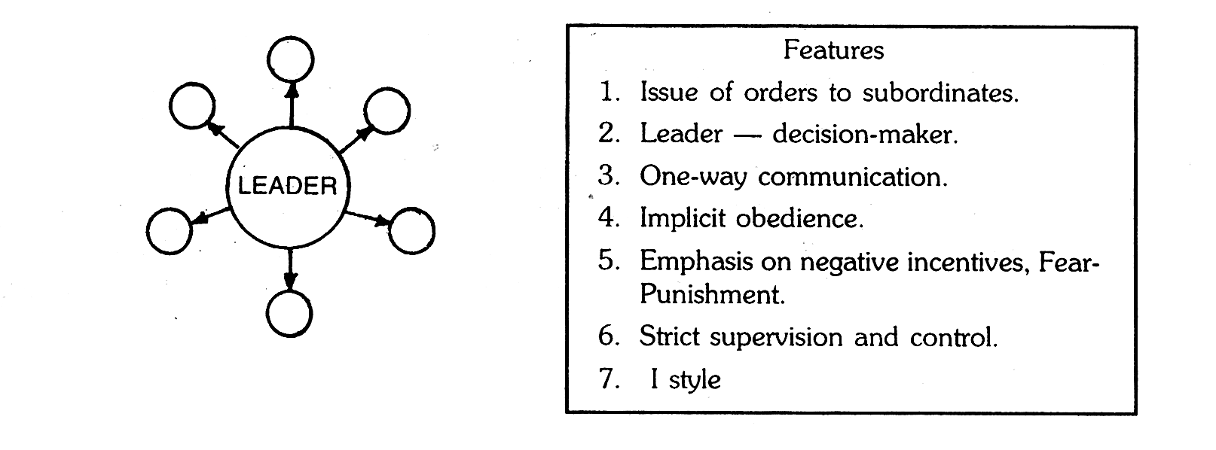
Autocratic Leadership :-

Slide 9
Democratic Leadership :-
Democratic leadership is the leadership style that promotes the sharing of responsibility. This has also been called shared leadership
Democratic Leadership is used:-
In manufacturing industry, to allow employees to give their ideas on how processes can be become more efficient.
Democratic leadership is effective in professionals organizations where the emphasis clearly on training, professional & leadership development and quality of work performed

Slide 10
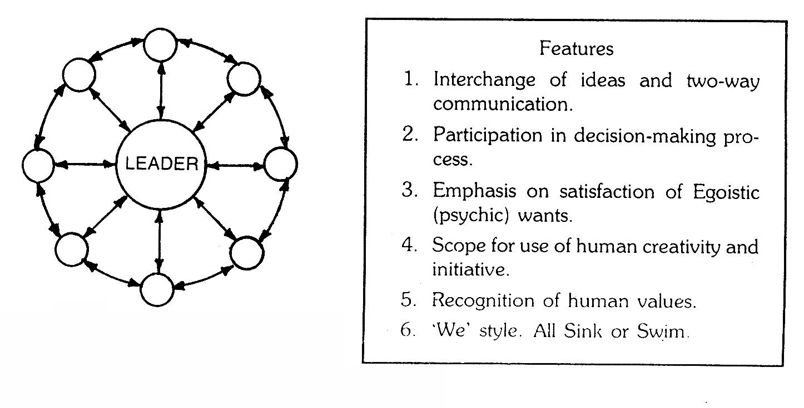
Democratic Leadership

Slide 11
Free Rein Leadership:-
A person may be in a leadership position without providing
leadership, subordinates are given a free hand in deciding their
own policies and methods. The subordinates are motivated to be
creative and innovative
Free Rein Leadership is used :-
Employees are highly skilled, experienced, and educated.
Employees have pride in their work .

Slide 12
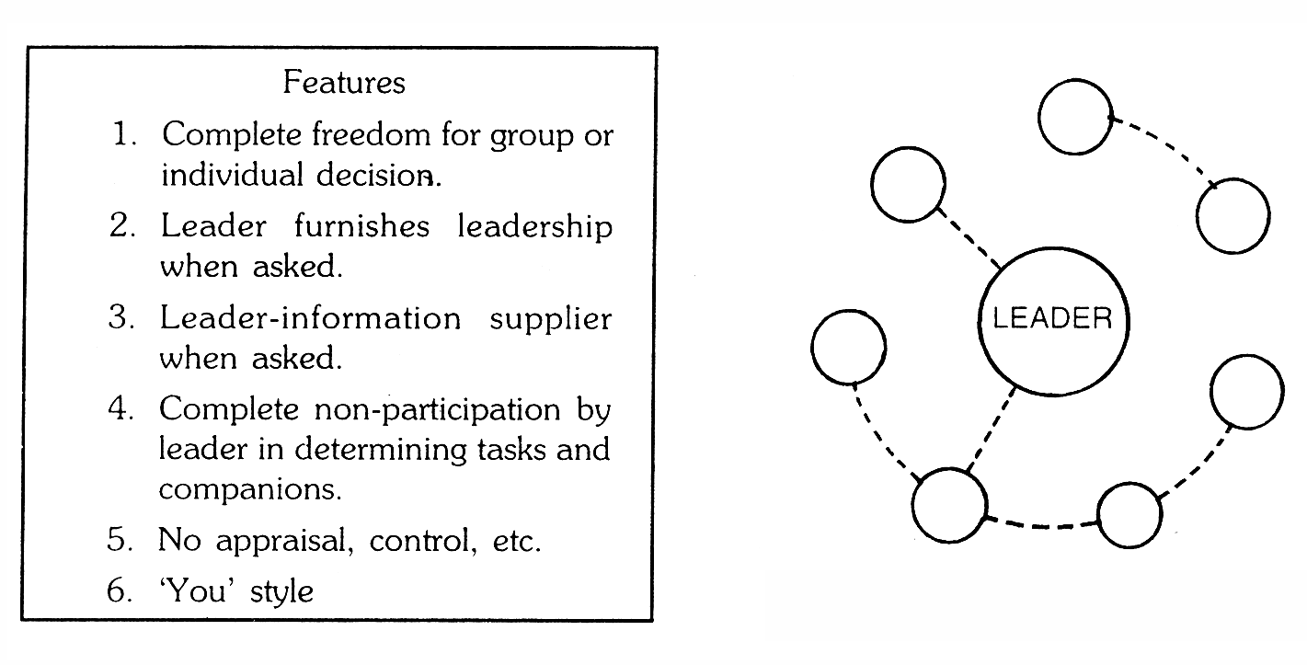
Free Rein Leadership

Slide 13
EXAMPLES OF LEADERSHIP
Mahatma Gandhi - A man of vision and conviction he was the man
of beliefs & actions
Pandit Nehru - A man of Socialism
Indira Gandhi - A Revolutionary women
Azim Premji - Vision

Slide 14
CONCLUSION
Each leadership is effective when it matches the needs of the situation
The situational approach to leadership style is most appropriate & realistic
Autocratic leadership is effective when decisions are routine
When rules for decision making are not standardized than democratic leadership is effective
People follow those leaders whom they recognize as a means of satisfying their won personal objectives.

